Slide 1




NEXT GEN EMPLOYABILITY PROGRAM
Creating a future-ready workforce
Team Members
College Name
Student Name : T. J. Adlin Bebisha
Student ID : au960221104007
Arunachala College of Engineering for Women

Slide 2

CAPSTONE PROJECT SHOWCASE
Project Title
Car Rentals Application with Django Framework
Abstract | Problem Statement | Project Overview | Proposed Solution | Technology Used | Modelling & Results | Conclusion

Slide 3
Abstract
This project aims to develop a web application for a car rental company using the Django framework, HTML, CSS, JavaScript, and Python. The application will allow customers to search for and book rental cars online, as well as manage their bookings. The application will also provide features for administrators to manage the car fleet, bookings, and customer accounts. Compared to the existing manual process, the proposed system provides time savings and convenience for both customers and administrators. It uses a modular design with separate modules for users, administrators and guests..
Source :

Slide 4
Problem Statement
The current car rental process often involves manual tasks and limited online capabilities, leading to inefficiencies for both renters and car owners/businesses. Here are some specific challenges:
Traditional methods for finding rental cars can be time-consuming, with limited filter options and unclear availability information.
Booking rentals often involves phone calls or in-person visits, requiring manual calculations for rental costs. Lack of online booking systems can lead to missed opportunities and delays.
Tracking available cars and managing rental schedules can be cumbersome without a centralized system.
Doesn’t fulfill the client requirements fully
Source :

Slide 5
Project Overview
This project will build a car rental application using the Django web framework. The backend will be written in Python with a focus on data models for cars, users, and rentals. The frontend will utilize HTML, CSS, and JavaScript to create a user-friendly interface for searching cars, managing reservations, and handling payments. The application will prioritize security features and offer functionalities like user accounts, trusted agent support (either human or AI assistant), and informative quotes to guide users through the rental process.
Source :

Slide 6
Proposed Solution
.
Project Setup: Create a new Django project and app for the car rental system
Models: Cars (details, availability), Users (accounts, payments), Rentals (bookings, pricing).
Functionality: Secure user login/registration, car search with filters, real-time booking with calendar integration, secure payment processing, user management (past rentals, information updates), admin panel (inventory management, pricing, user inquiries).
Frontend (HTML, CSS, JavaScript):User-friendly interface with car information, search results, rental details, and user profiles.Responsive design for various devices.
Security: Prioritize secure authentication, data encryption, and protection against vulnerabilities.
Integrations: Explore payment gateways and location services (optional).
Scalability: Design for future growth and feature additions.
Deployment: Consider cloud platforms like Heroku or AWS for easy maintenance and scalability.
Source :

Slide 7
Creating a Next Gen Employability program for a car rentals application involves several components:
Skill Development: Identify key skills required for roles within the company, such as customer service, sales, vehicle maintenance, and administration.
Training Modules: Develop training modules focusing on these skills, including both theoretical knowledge and practical application.
Technology Integration: Incorporate training on using the car rentals application effectively, including booking management, vehicle tracking, and customer communication features.
Soft Skills: Include training on soft skills like communication, problem-solving, teamwork, and adaptability, essential for success in any role.
Source :

Slide 8
Mentorship Program: Pair new hires with experienced employees to provide guidance and support throughout their training period.
Assessment and Feedback: Implement regular assessments to track progress and provide constructive feedback to employees, helping them improve continuously.
Career Path Development: Offer opportunities for advancement within the company, with clear pathways and development plans for employees to progress in their careers.
Continuous Learning: Encourage a culture of continuous learning and skill development through ongoing training sessions, workshops, and access to online resources.
By implementing these components, the Next Gen Employability program can effectively prepare employees for success within the car rentals application, enhancing their employability and contributing to the company's overall success.
Source :

Slide 9


Technology Used
Front-end
Back-end
Source :

Slide 10
Modelling & Results
The car rental application will utilize Django on the backend for data modeling. This involves creating models in Python for Cars (including details like make, features, and availability), Users (with secure login information and payment methods), and Rentals (tracking booked cars, dates, and pricing). The HTML, CSS, and JavaScript on the frontend will translate this data into a user-friendly experience. Cars will be searchable based on various filters, and a calendar will facilitate booking. Integration with a payment gateway will handle secure transactions. The result will be a user-friendly, secure car rental application offering functionalities like user accounts, real-time booking, and informative displays – all powered by Django's backend framework and a visually appealing frontend.
Source :

Slide 11
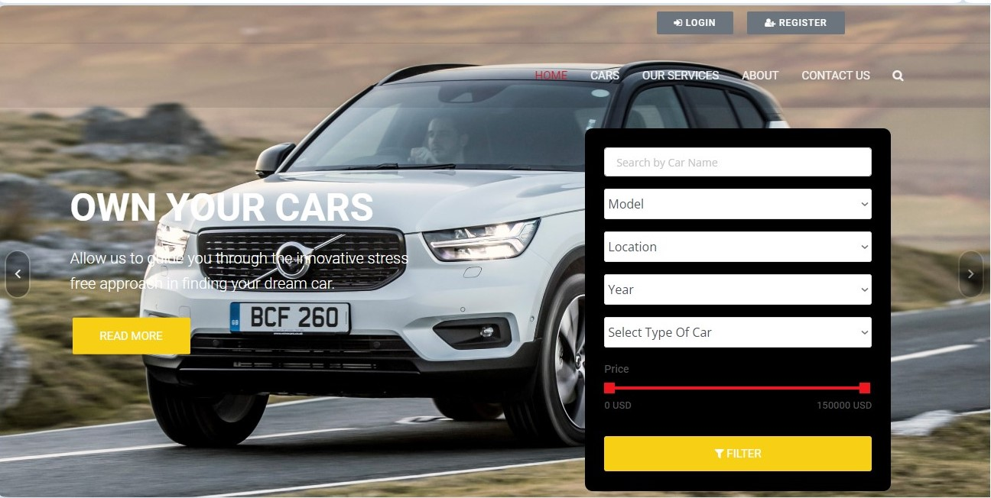
Homepage

Slide 12
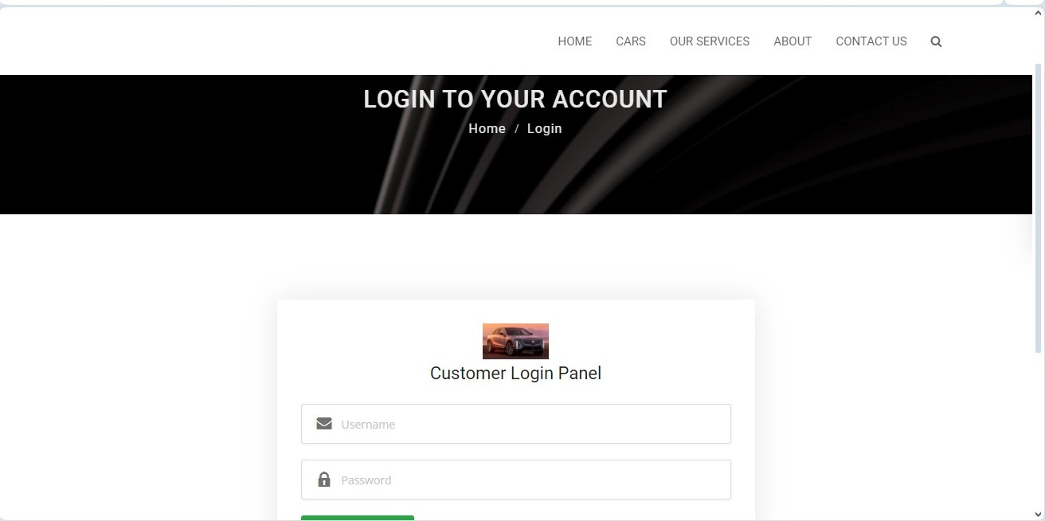
Login Page

Slide 13
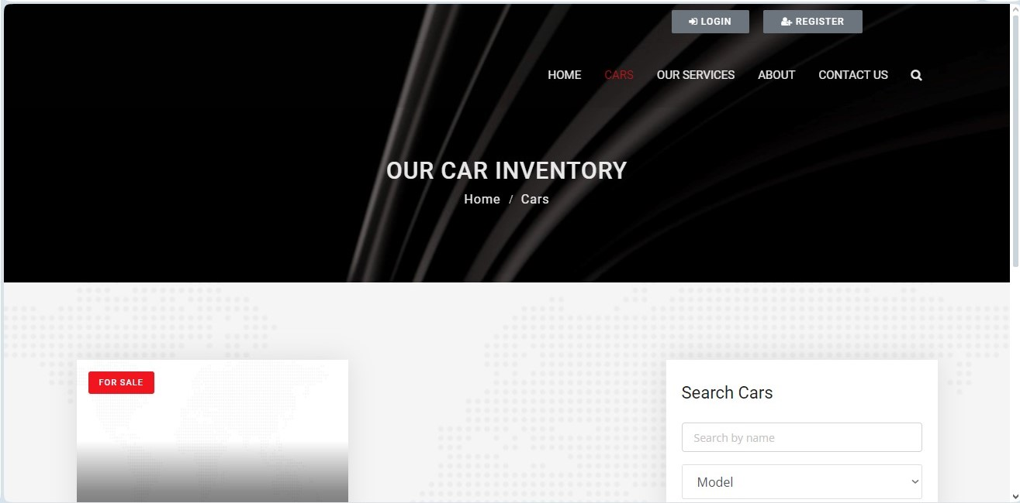
Cars

Slide 14
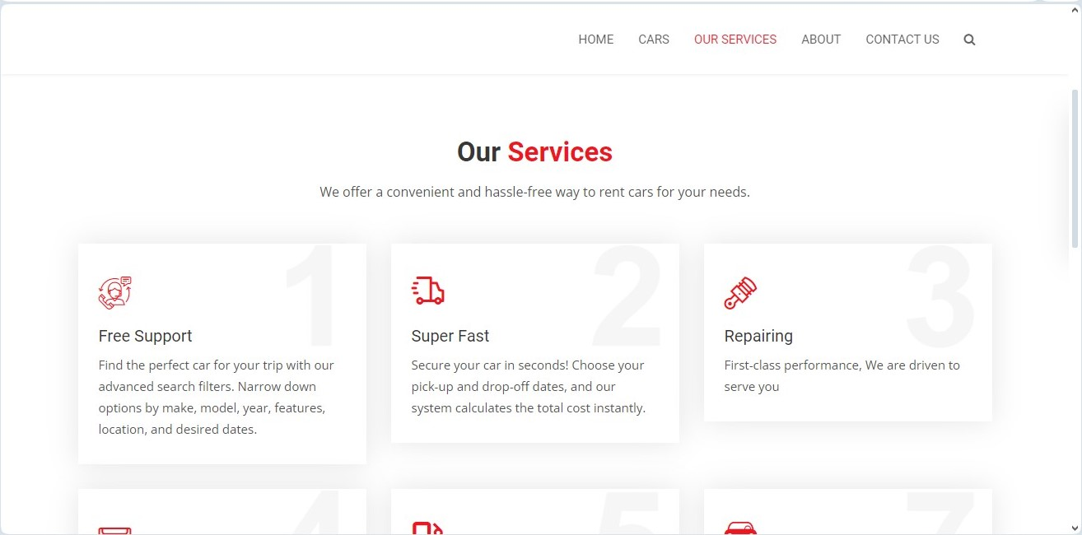
Service-Page

Slide 15
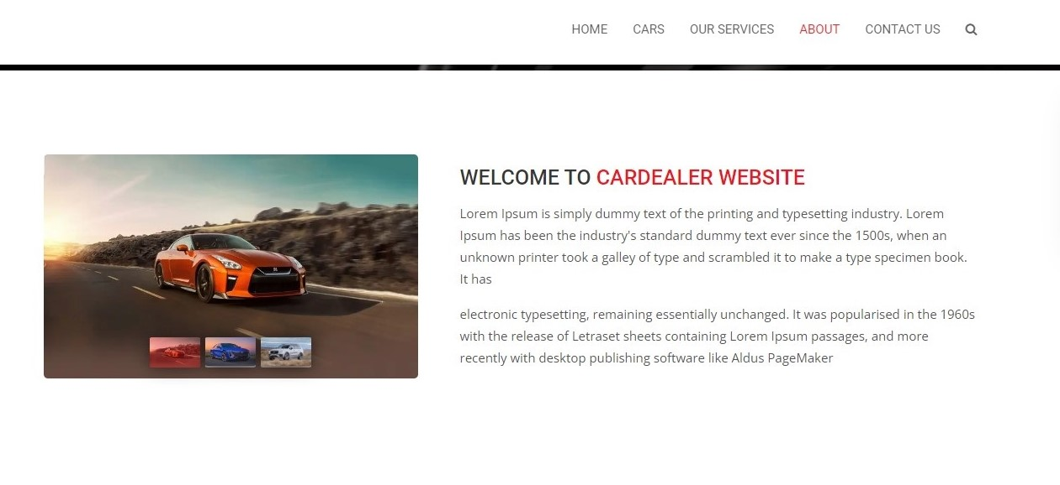
About-Us-Page

Slide 16
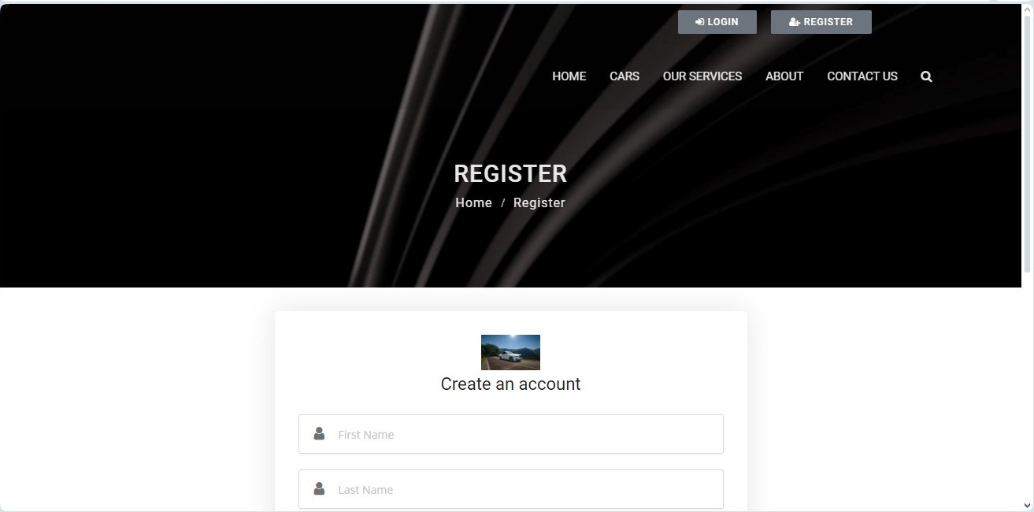
Register Page

Slide 17
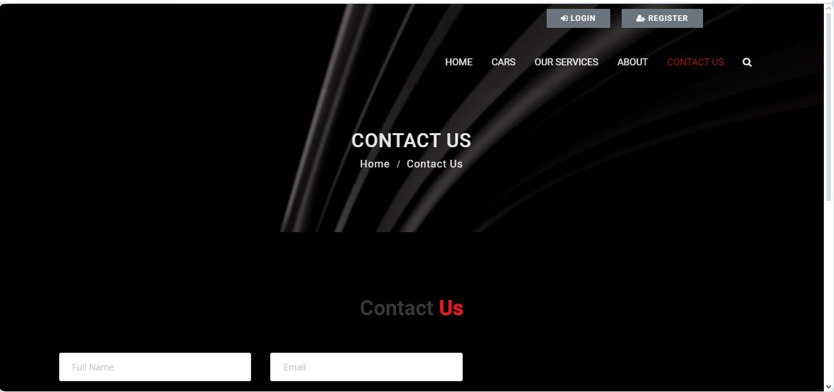
Contact Us

Slide 18
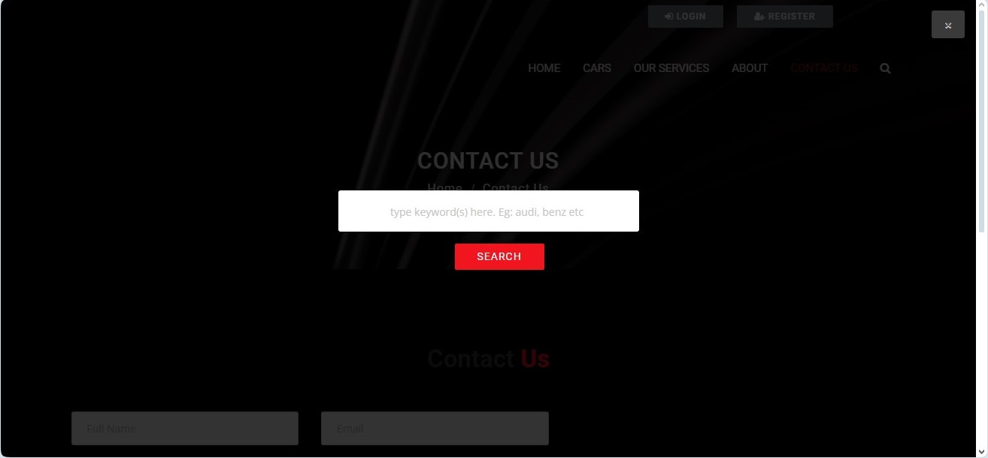
Search Page

Slide 19
Future Enhancements:
Advanced Features: Integrate with location services to offer real-time estimated arrival times for pick-up/drop-off or suggest nearby gas stations. Implement a loyalty program rewarding frequent renters with discounts or upgrades.
Mobile Application Development: Develop a native mobile application for a seamless rental experience on the go. This could leverage functionalities like geolocation for easier pickup/drop-off and mobile payment options
Data Analytics & Reporting: Utilize Django's data analysis tools to track user behavior and rental trends. Generate reports to optimize pricing strategies, identify popular car models, and improve resource allocation.
User Experience Enhancements: Incorporate a live chat feature for customer support or explore chatbot functionalities for answering common questions. Allow users to rate and review their rental experience for car and location feedback.

Slide 20
Conclusion
The proposed car rental application, built with Django, HTML, CSS, and JavaScript, offers a user-friendly and secure platform for managing car rentals. The Django backend ensures robust data management with models for cars, users, and rentals. The HTML, CSS, and JavaScript provide a visually appealing and interactive frontend for searching cars, booking rentals, and processing payments. This application prioritizes security and offers features like user accounts, trusted agent support, and informative displays. Future enhancements can include advanced features, user experience improvements, data analytics, and mobile app development, creating a comprehensive and data-driven car rental solution.
Source :

Slide 21
Thank You!
Notes:
Thank You !!

